Slide 1














TEXT
SUMMARIZATION
PREPARED BY:
KUSH MODI

Slide 2

INTRODUCTION
Converts long articles into concise, easy-to-read summaries.
Enables quick understanding of key points in news, research, or social media.
Summarization presents challenges in maintaining clarity and main ideas.
Utilizes the `facebook/bart-large-cnn` model for high-quality results.
Aims to streamline the comprehension of extensive information.

Slide 3

SAMSUM DATASET OVERVIEW
Approximately 16,000 dialogue-summary pairs.
Dialogues based on real-life conversations.
Designed for training and evaluating summarization models.
Features diverse topics and realistic, informal language.

Slide 4





Transformer-based encoder-decoder model
vocabulary size of 50,265 tokens.
12 layers in both encoder and decoder
MODEL
Approximately
406 million parameters.
1024 units in hidden layers.
Trained on the
BooksCorpus and English Wikipedia.

Slide 5


DATA HANDLING AND TRAINING WORKFLOW
PREPROCESSING
TRAINING
Tokenizes and encodes dialogues and summaries, truncating to 1024 tokens.
Prepares the SAMSum dataset, formatting it to PyTorch tensors.
Uses DataCollatorForSeq2Seq for dynamic padding during training.
Sets training parameters, including epochs, batch size, and evaluation steps.
Configures early stopping to halt training if performance doesn't improve.
Initializes Trainer with model, arguments, and datasets, and starts training.

Slide 6
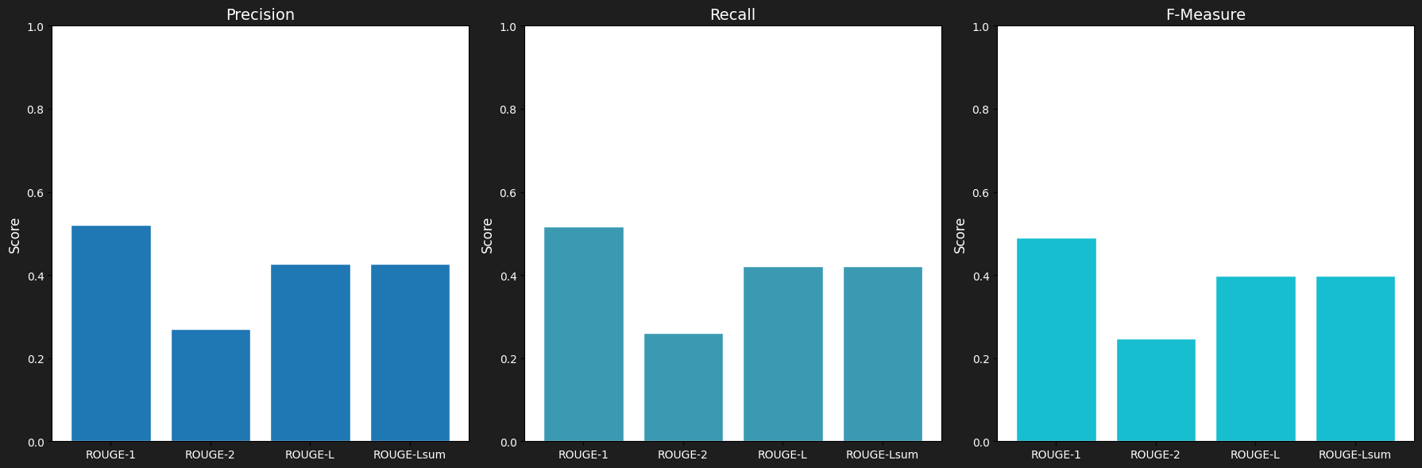
EVALUATION

Slide 7
THANK YOU VERY MUCH!

